Slide 1
Book Your Health: A Doctor-Patient Appointment System
.

Slide 2
Introduction
Benefits of the Doctor Patient Appointment Booking System
Features of the Doctor Patient Appointment Booking System
Challenges of Implementing the Doctor Patient Appointment Booking System
Conclusion

Slide 3

Introduction
The doctor patient appointment booking system is a web-based platform that allows patients to schedule appointments with their doctors online. This system has revolutionized the way healthcare providers manage their schedules and interact with patients.
With this system, patients can easily book appointments with their preferred doctors at any time of the day or night, without having to wait on hold or visit the doctor's office in person.

Slide 4

Benefits of the Doctor Patient Appointment Booking System The doctor patient appointment booking system offers several benefits to both patients and healthcare providers. For patients, it provides a convenient and hassle-free way to book appointments with their doctors. They can do so from the comfort of their own homes, without having to take time off work or travel to the doctor's office. For healthcare providers, the system streamlines the appointment booking process and reduces administrative workload. It also helps to reduce no-shows and cancellations by sending reminders to patients before their scheduled appointments.

Slide 5
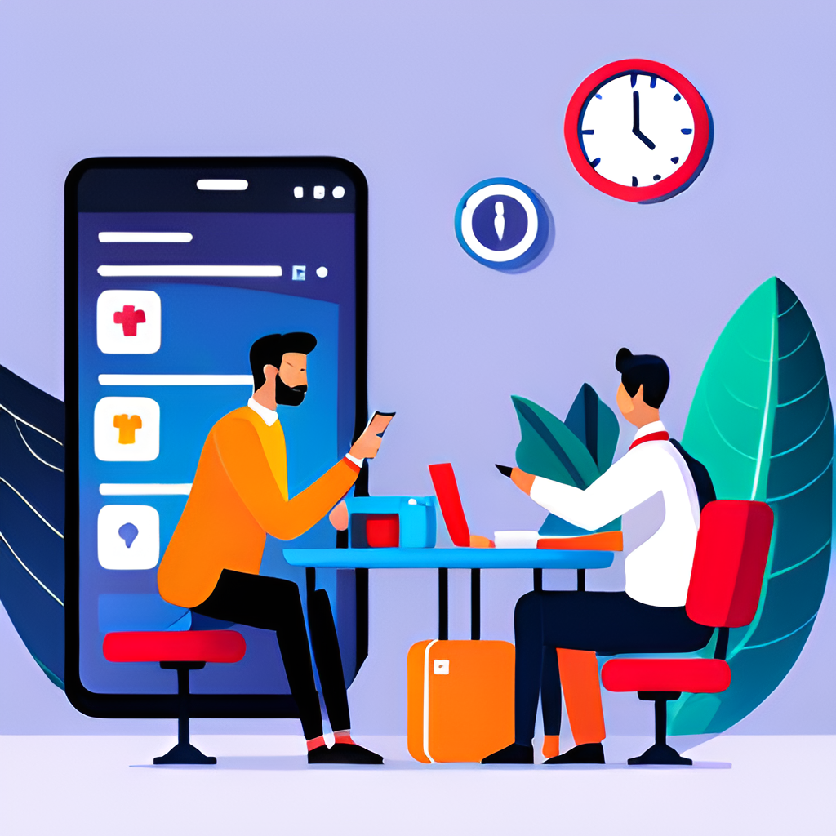
Features of the Doctor Patient Appointment Booking System The doctor patient appointment booking system comes with several features that make it easy to use and highly effective. These include a user-friendly interface, real-time availability of doctors, automated appointment reminders, and secure payment processing.
.

Slide 6

Challenges of Implementing the Doctor Patient Appointment Booking System While the doctor patient appointment booking system offers several benefits, it also comes with its own set of challenges. One of the biggest challenges is getting patients and healthcare providers to adopt the system. Another challenge is ensuring that the system is secure and complies with privacy regulations. Healthcare providers must ensure that patient data is protected and that the system meets HIPAA requirements.
.

Slide 7
SOFTWARE’S USED
PYTHON(FLASK)
HTML
CSS
MYSQL

Slide 8
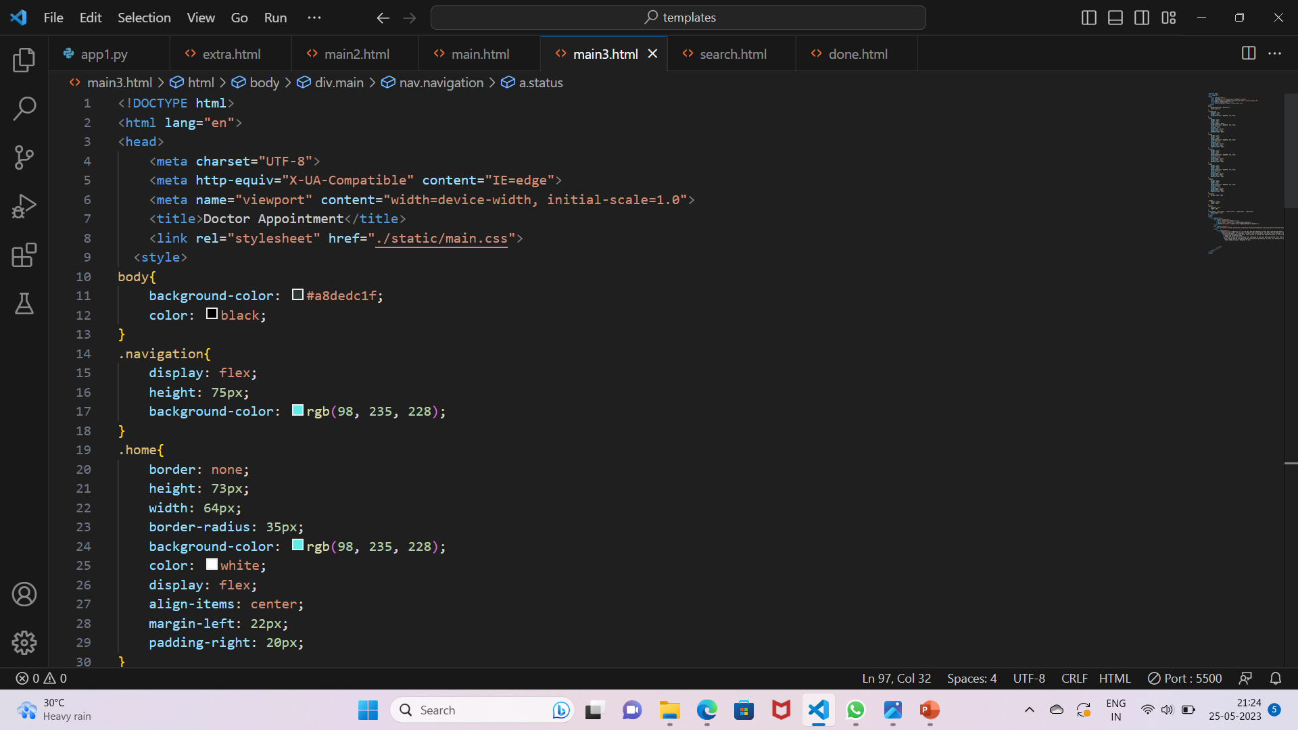
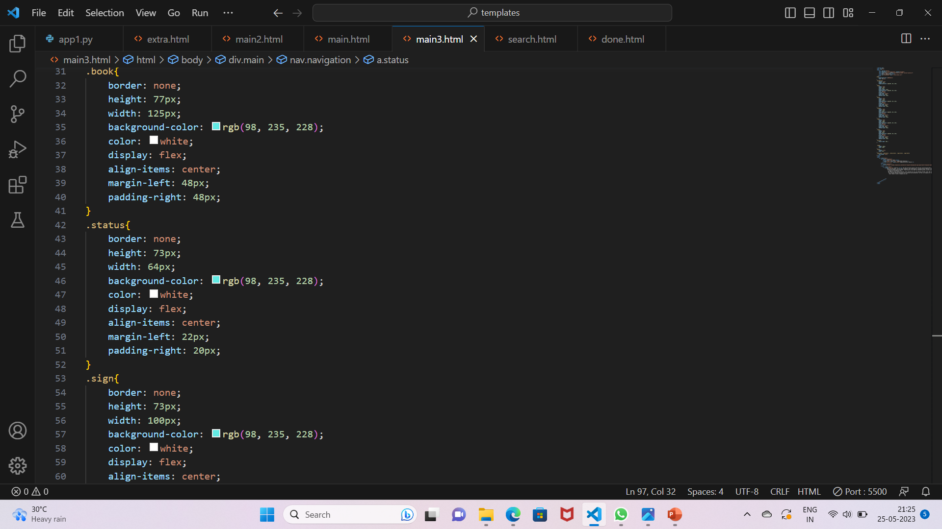
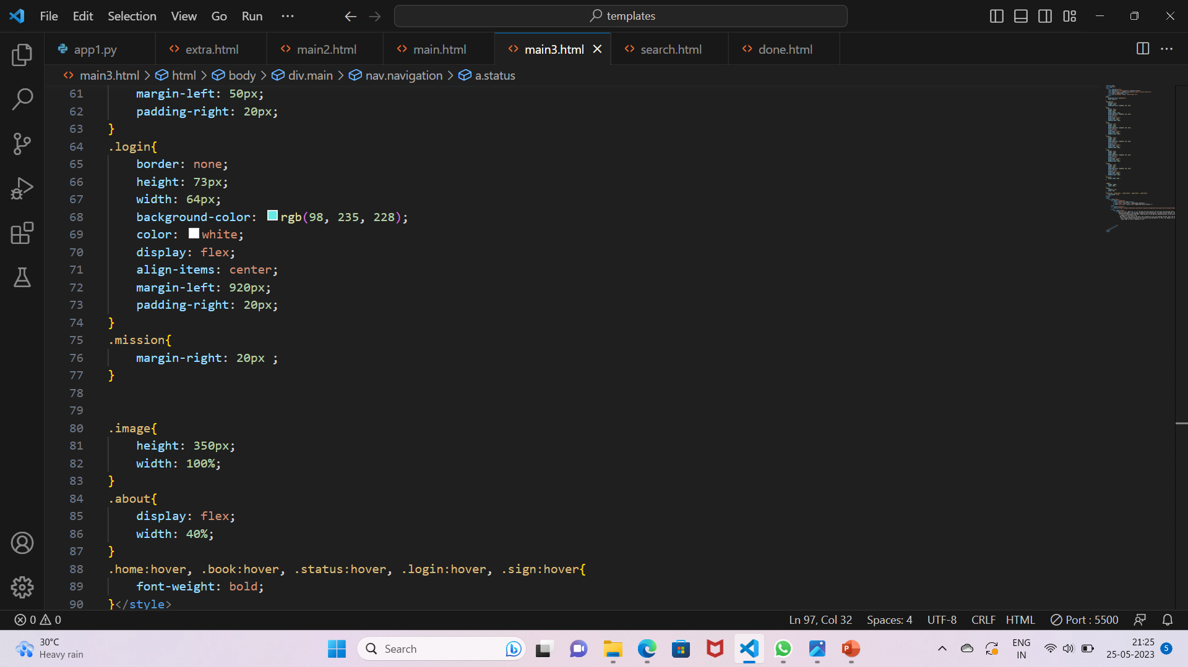
HOME PAGE CODE

Slide 9
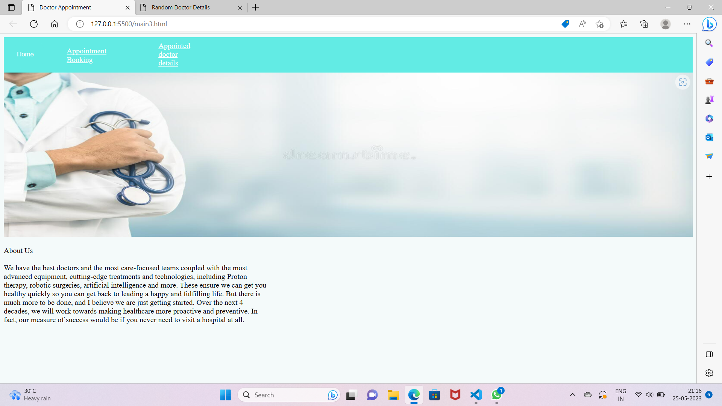
Business opportunities are like buses. There’s always another one coming.
“
”
Richard Branson

Slide 10
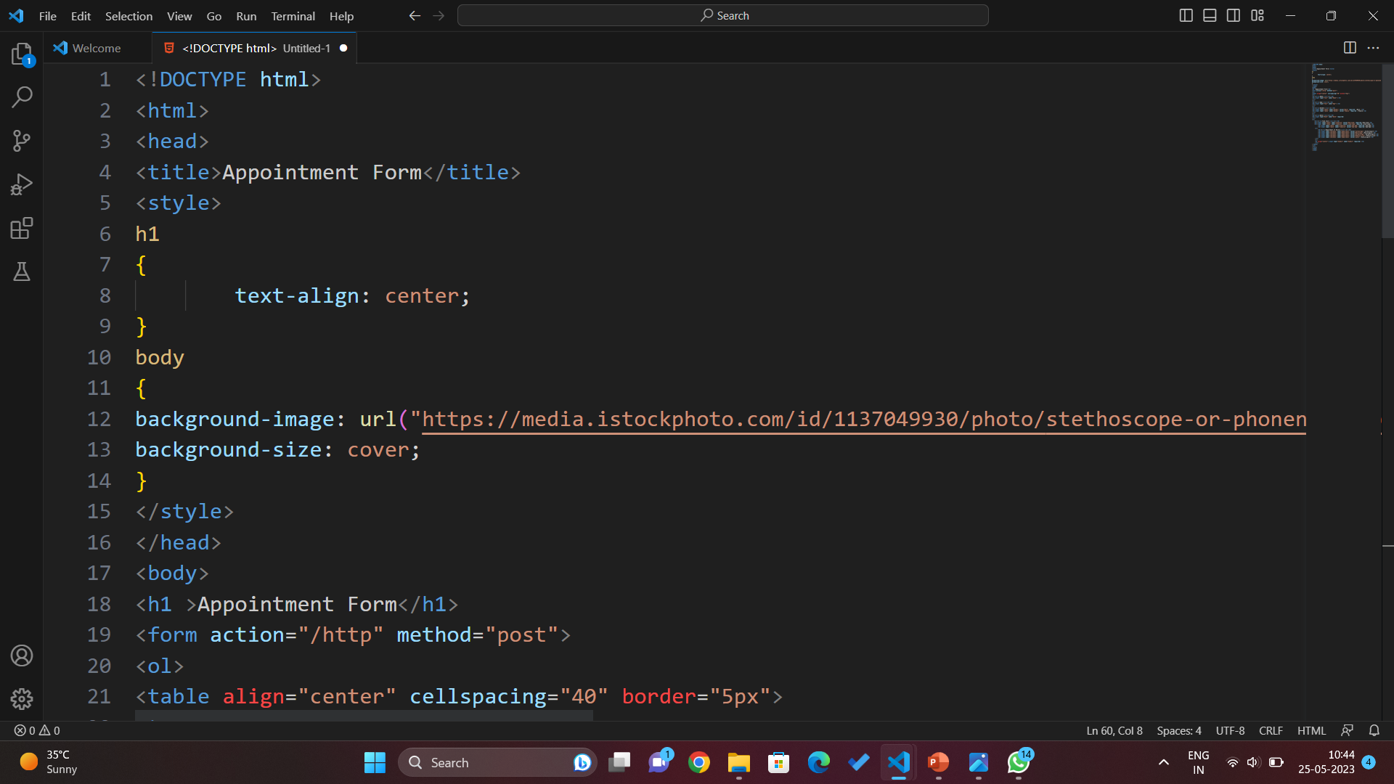
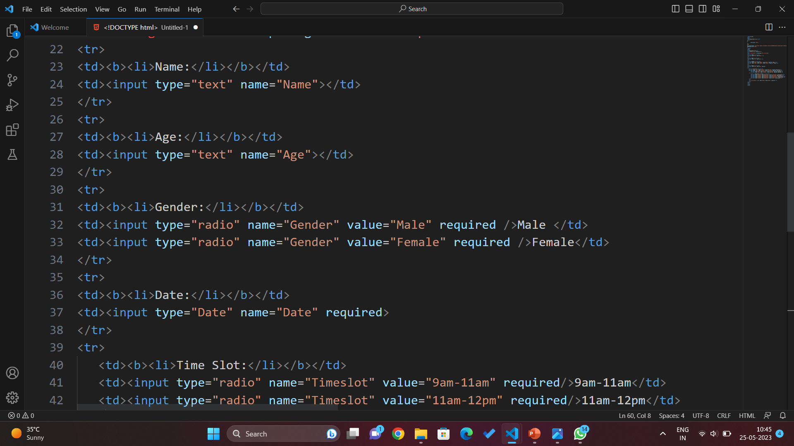
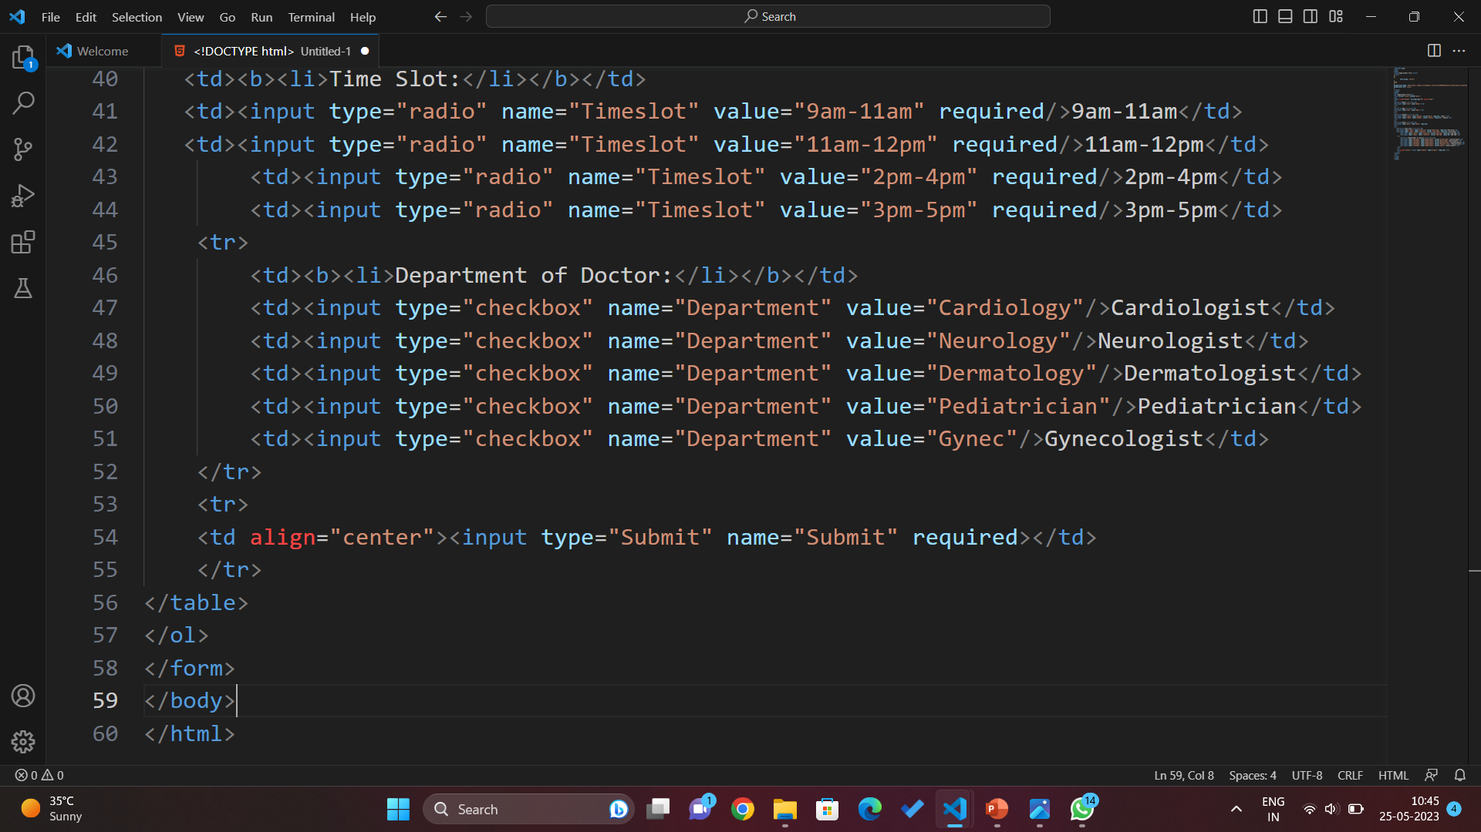
APPOINTMENT FORM

Slide 11
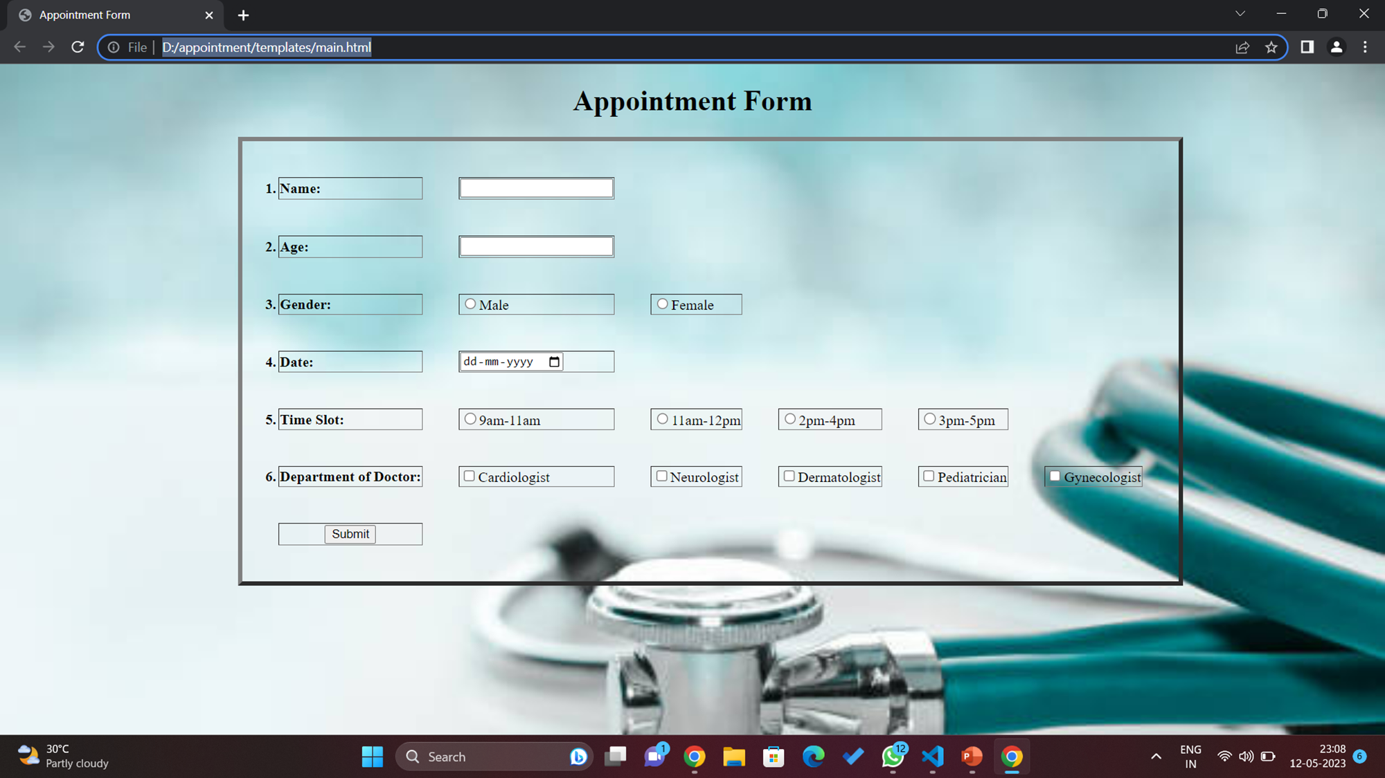




Meet our team
Takuma Hayashi
Mirjam Nilsson
Flora Berggren
Rajesh Santoshi
President
Chief Executive Officer
Chief Operations Officer
VP Marketing

Slide 12
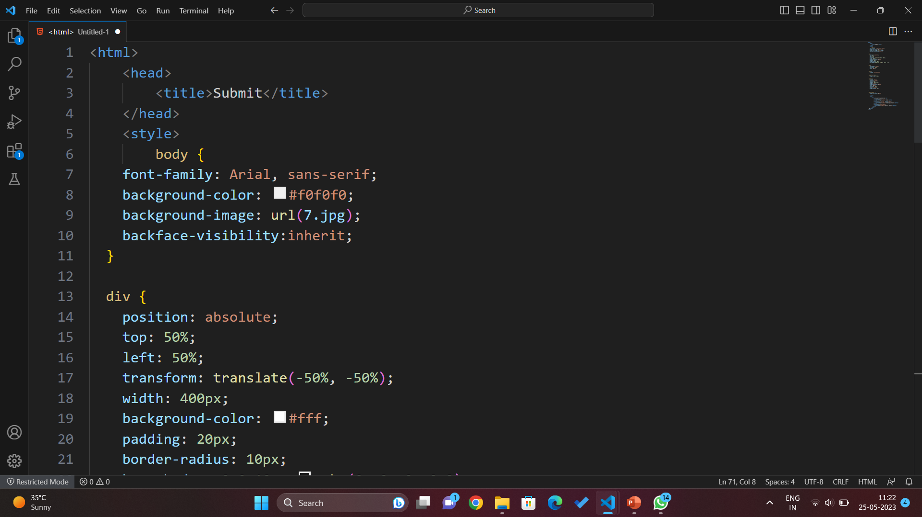
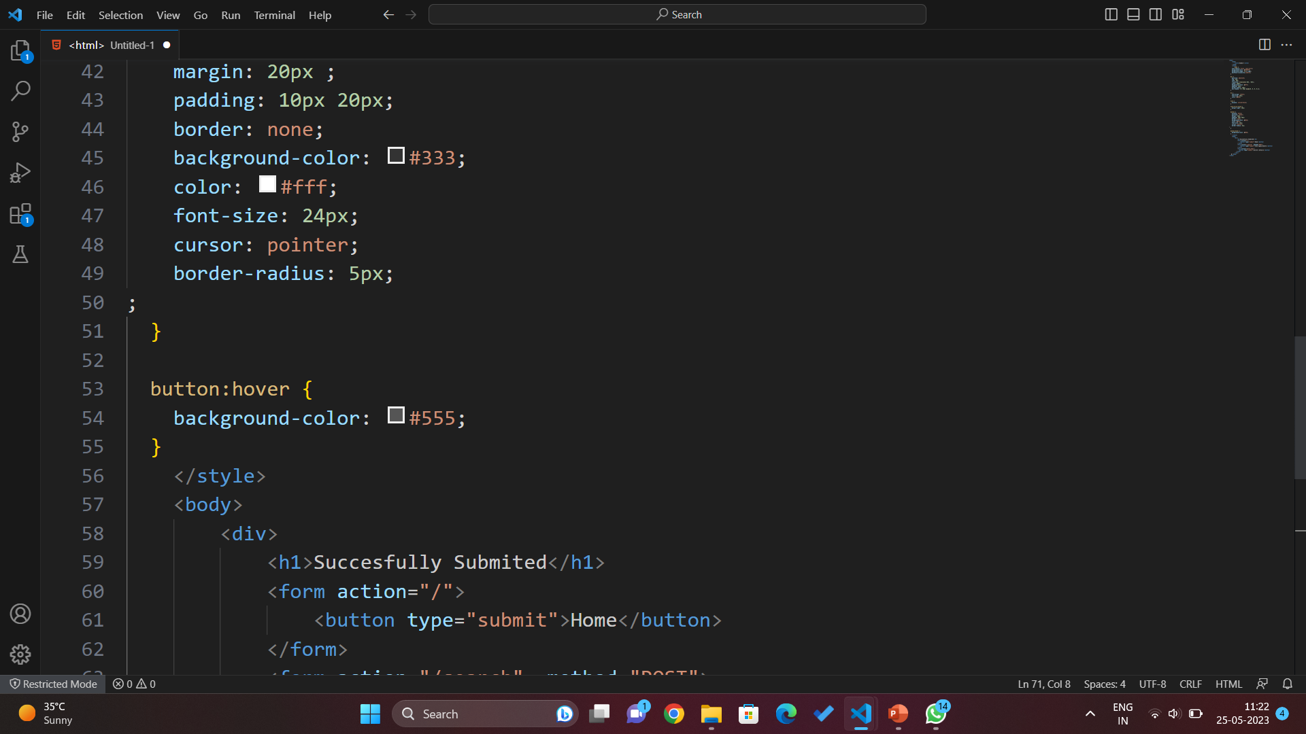
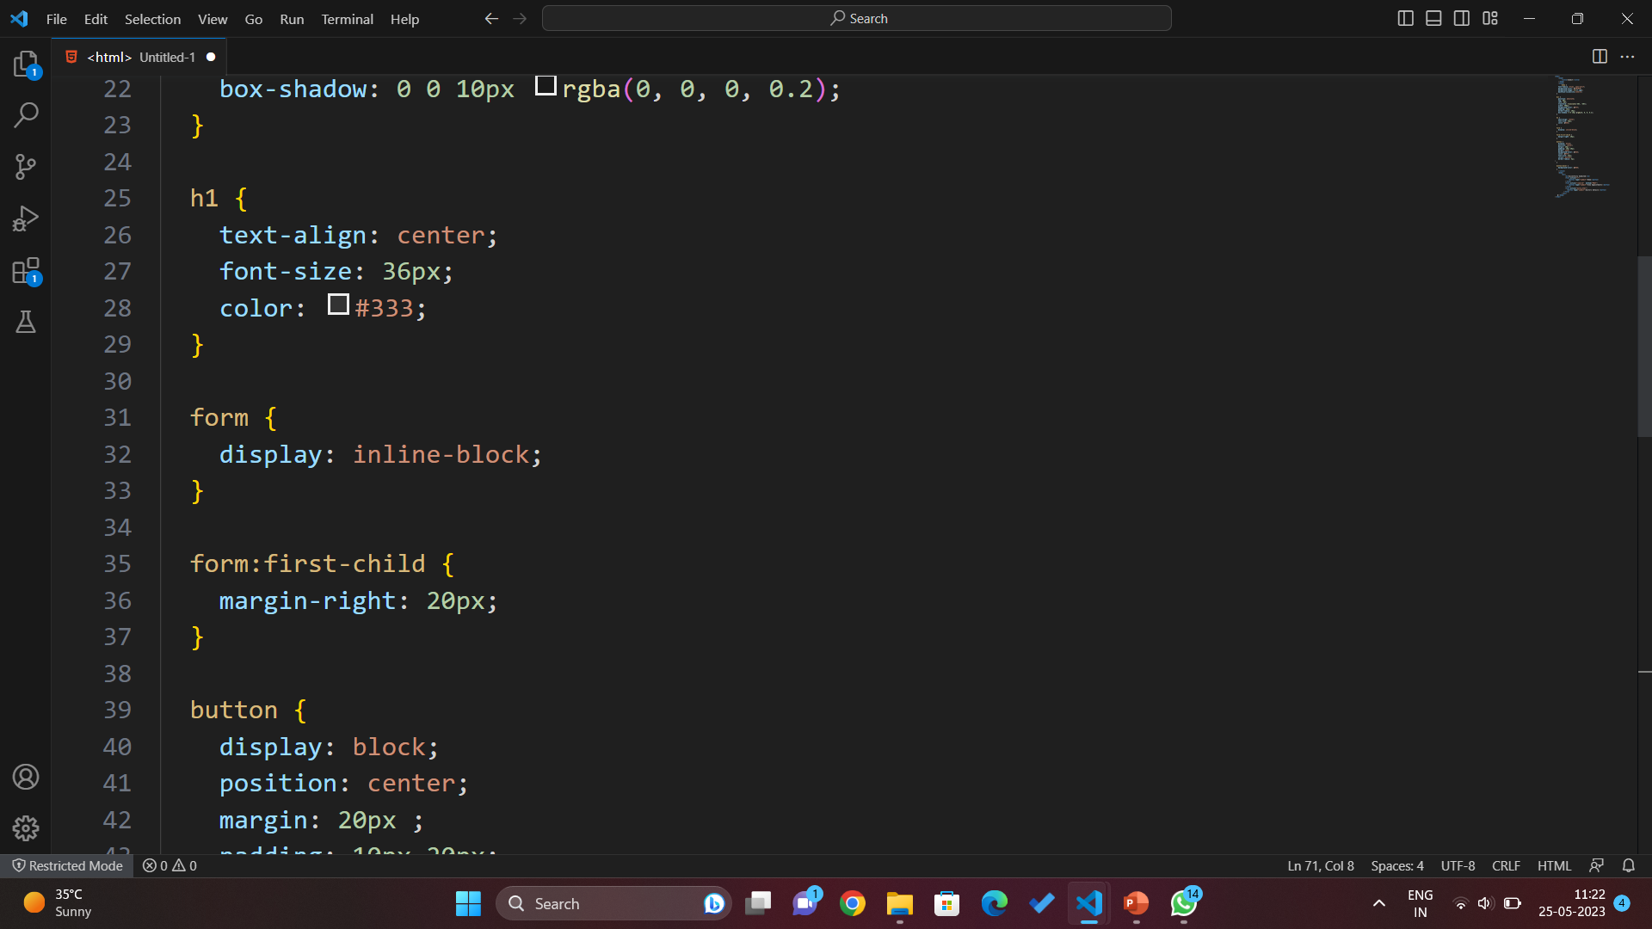
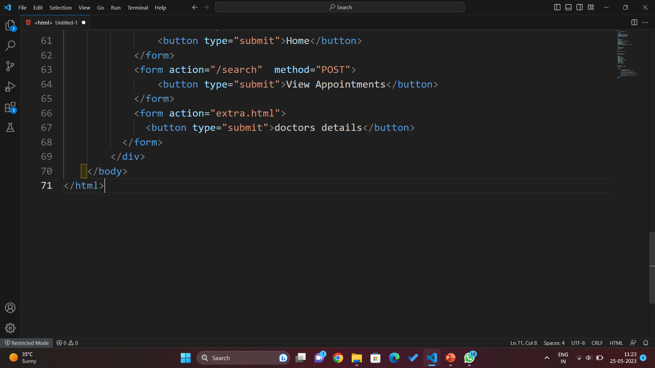
CONFIRMATIONM FORM

Slide 13
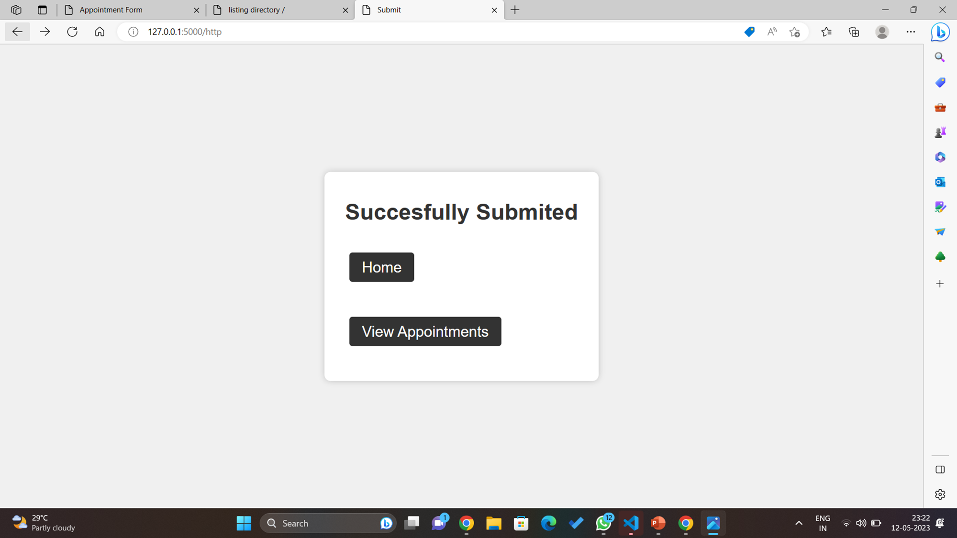








Meet our extended team
Takuma Hayashi
Mirjam Nilsson
Flora Berggren
Rajesh Santoshi
President
Chief Executive Officer
Chief Operations Officer
VP Marketing
Graham Barnes
Rowan Murphy
Elizabeth Moore
Robin Kline
VP Product
SEO Strategist
Product Designer
Content Developer

Slide 14
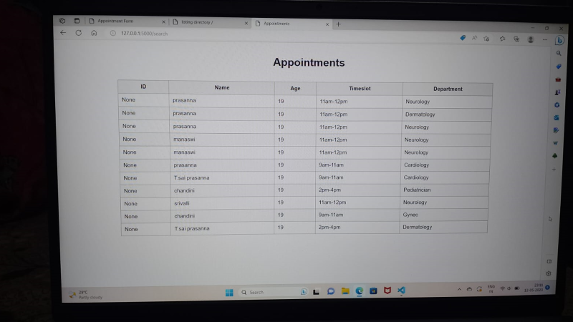





Plan for product launch
Planning
Synergize scalable e-commerce
Marketing
Disseminate standardized metrics
Design
Coordinate e-business applications
Strategy
Foster holistically superior methodologies
Launch
Deploy strategic networks with compelling e-business needs

Slide 15
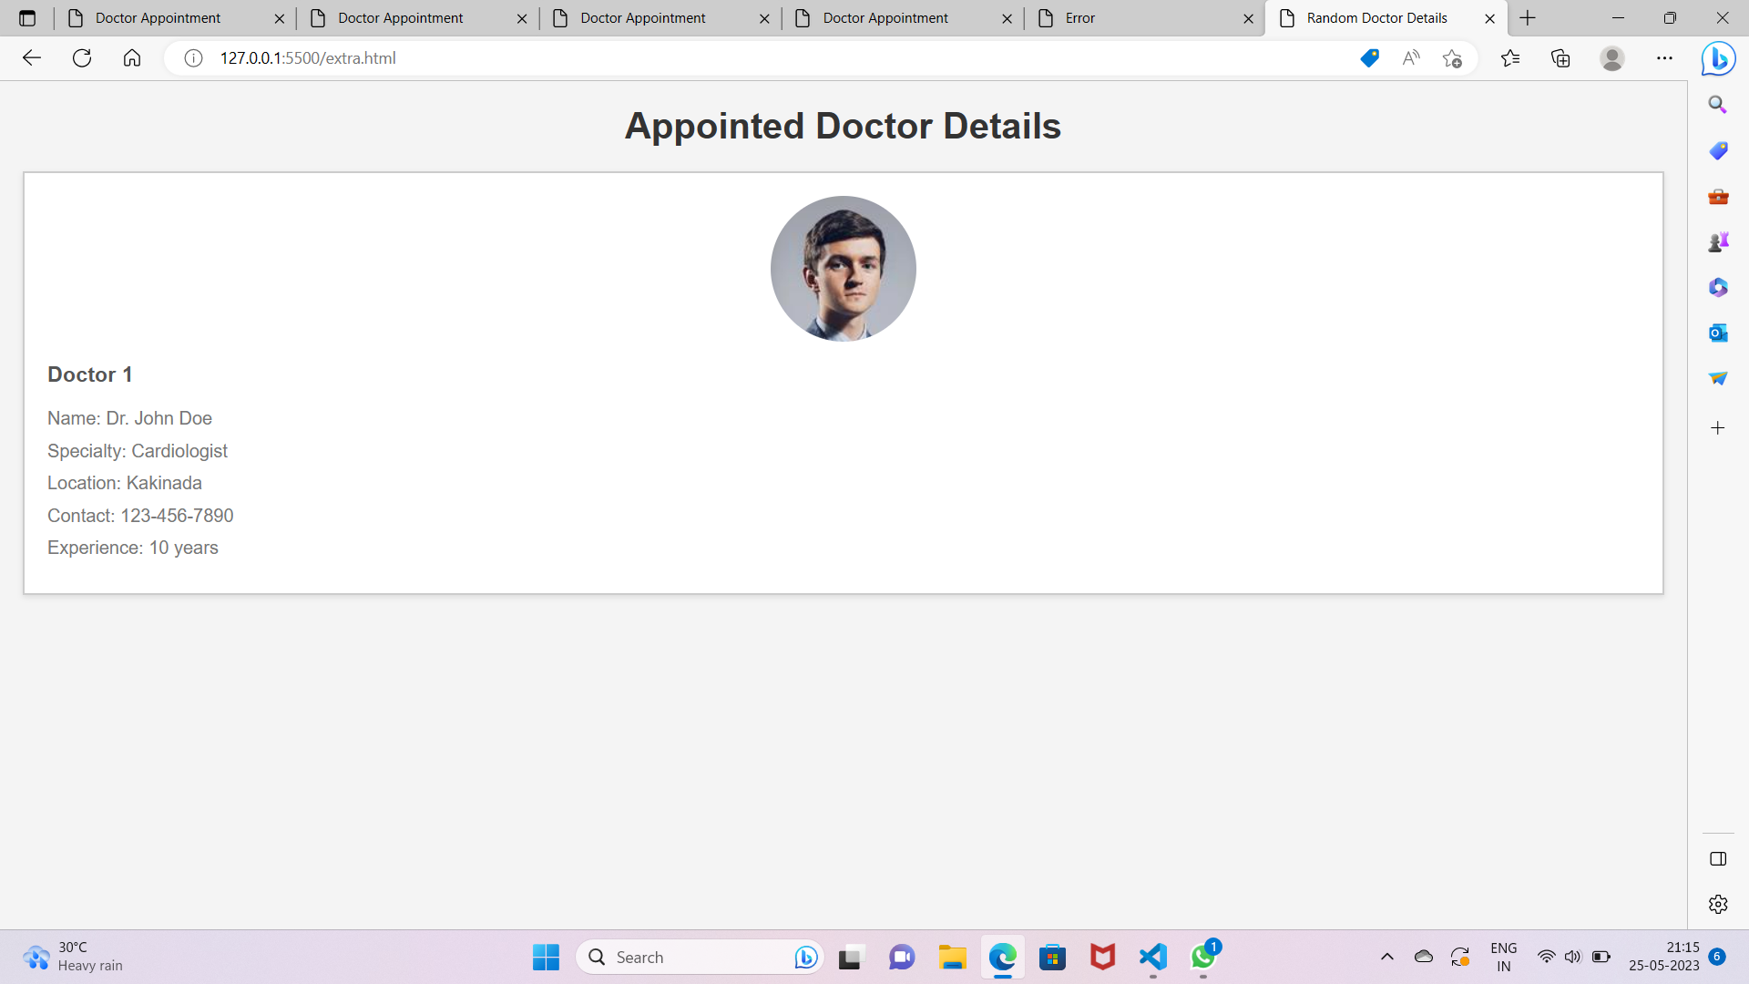

Slide 16
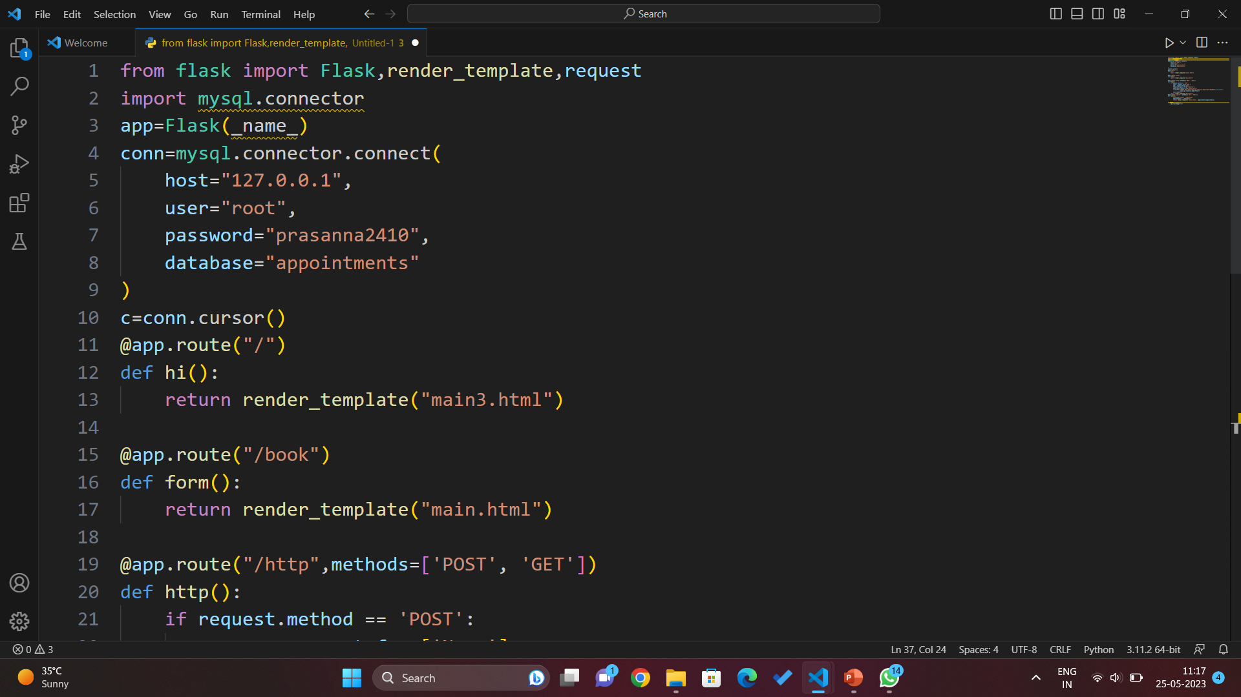
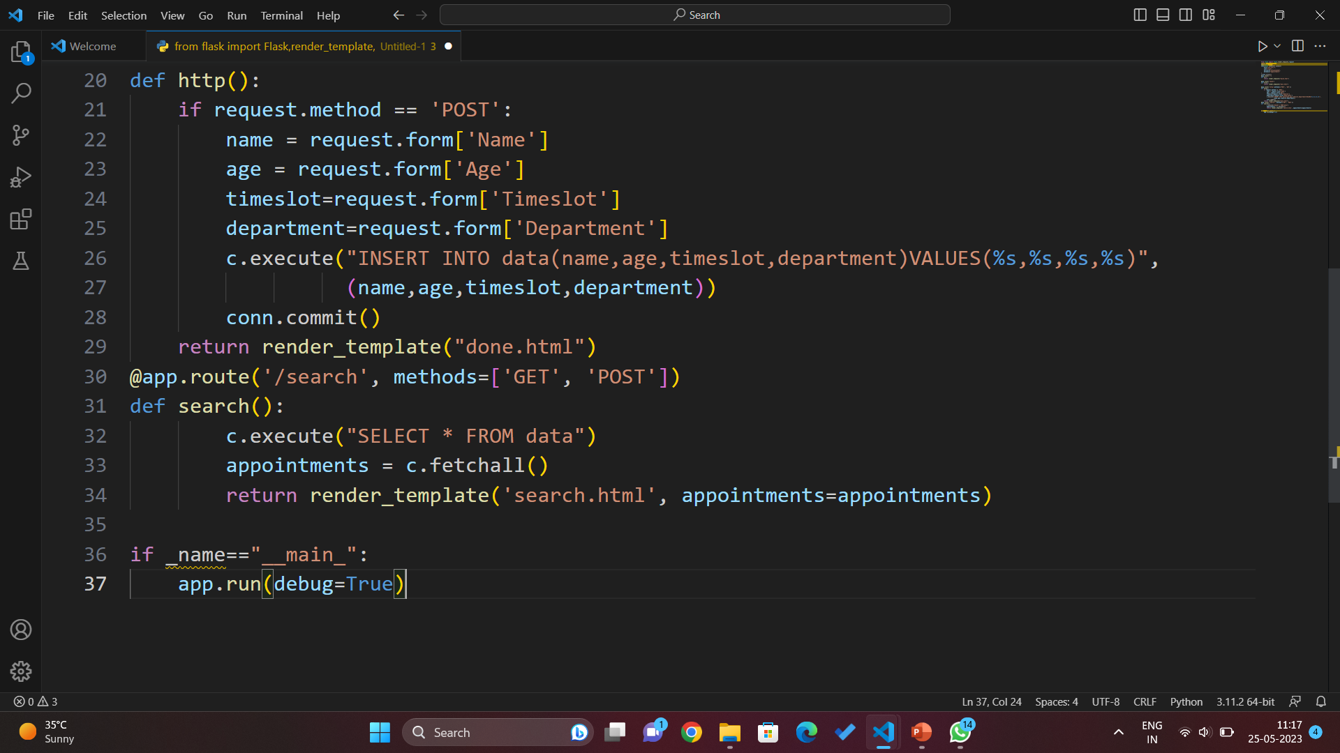
Python Flask

Slide 17

Conclusion In conclusion, the doctor patient appointment booking system is a game-changer in the healthcare industry. It offers several benefits to both patients and healthcare providers, including convenience, efficiency, and increased patient satisfaction. As technology continues to advance, we can expect to see more healthcare providers adopting the doctor patient appointment booking system in the near future.
.

Slide 18
TEAM MEMBERS
.
.
.
PRASANNA
CHANDINI
MANASWI

Slide 19
Thank you

